Slide 1
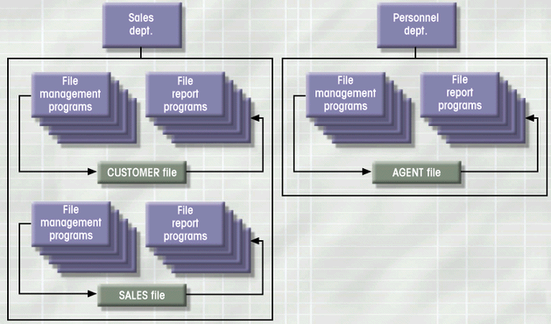
Example of a Simple File System

